Slide 1
Network Access Control
http://en.wikipedia.org/wiki/Network_Access_Control
  “an approach to computer network security that attempts to unify endpoint security technology (such as antivirus, host intrusion prevention, and vulnerability assessment), user or system authentication and network security enforcement”
Aim: to control endpoint security by unifying it with network device security and the whole network
Result: End devices that do not comply to the set security policies are identified and quarantined.

Slide 2
Why and What?
Why NAC?
  http://www.ashimmy.com/2007/03/a_brief_history.html
  “The biggest driver for NAC was the realization that after spending billions on the perimeter, we still were not any more secure.” Why? Internal threats …
What is NAC?
  http://www.ashimmy.com/2007/03/nac_bust_or_boo.html
  “The original concept of NAC was performing pre-admission health or profile checks on devices as they sought to enter the network. If the device failed they were denied access or quarantined. Then we added post-admission vulnerability scans, then IDS detection, behavior based detection, identity based access controls, etc. Before you know it, anything that has anything to do with getting on the network and staying there is part of NAC.”
Network Security

Slide 3
NAC: Goals
http://en.wikipedia.org/wiki/Network_Access_Control
Mitigation of non-zero-day attacks (?)
  To prevent end-stations that lack antivirus, patches, or host intrusion prevention software from accessing the network and placing other computers at risk of cross-contamination
Policy enforcement
  To allow network operators to define policies, such as the types of computers or roles of users allowed to access areas of the network, and enforce them in switches, routers, and network middleboxes (like firewalls).
Identity and access management
  Instead of using IP addresses, NAC enforces network access based on authenticated user identities, at least for user end-stations such as laptops and desktop computers.

Slide 4
NAC Basic Concepts
Source: http://en.wikipedia.org/wiki/Network_Access_Control
Pre-admission vs Post-admission enforcement
Agent vs Agentless data collection
  An agent s/w runs on the endpoint to report the status
  Agentless devices
    Some devices do not support NAC agent s/w
    e.g., printers, scanners, phones, photocopiers, and other special devices
    NAC uses scanning and network inventory techniques (whitelisting, blacklisting, ACLs) to discern those characteristics remotely
Network Security

Slide 5
NAC Basic Concepts
Source: http://en.wikipedia.org/wiki/Network_Access_Control
Out-of-band vs Inline solutions
  Inline: A single box acts as an internal firewall for access-layer networks and enforces the policy
  Out-of-band: Agents on end-stations report information to a central console, which in turn control switches to enforce policy.
Network Security

Slide 6
NAC Basic Concepts
Source: http://en.wikipedia.org/wiki/Network_Access_Control
Quarantine vs captive portals for remediation
Quarantine: A non-compliant end-station is only allowed to access a restricted network with patch and update servers.
Captive portals: The captive portal technique forces an HTTP client on a network to see a special web page before gaining full access.
  In NAC, a captive portal intercepts HTTP access to web pages, redirecting users to a web application that provides instructions and tools for updating their computers.
Network Security

Slide 7
Cisco’s NAC
Source: http://www.cisco.com/en/US/prod/collateral/vpndevc/ps5707/ps5923/product_data_sheet0900aecd80119868.html
NAC is a set of technologies and solutions built on an industry initiative led by Cisco Systems®.
NAC uses the network infrastructure to enforce security policy compliance on all devices seeking to access network computing resources, thereby limiting damage from emerging security threats such as viruses, worms, and spyware.
Network Security

Slide 8
Why NAC?
Endpoints that do not comply with established security policies pose a threat and can introduce a security risk into the network.
Goal of NAC: to prevent vulnerable and noncompliant hosts from obtaining network access
  Q: Why isn’t user authentication (like 802.1x) sufficient?
  Ans?
Network Security

Slide 9
Cisco’s approach to NAC
The NAC solution uses the network access devices (NAD) to protect the network infrastructure from any endpoint seeking network access.
  Only compliant endpoints are granted access.
  Noncompliant devices are denied access and quarantined for remediation.
Network Security

Slide 10
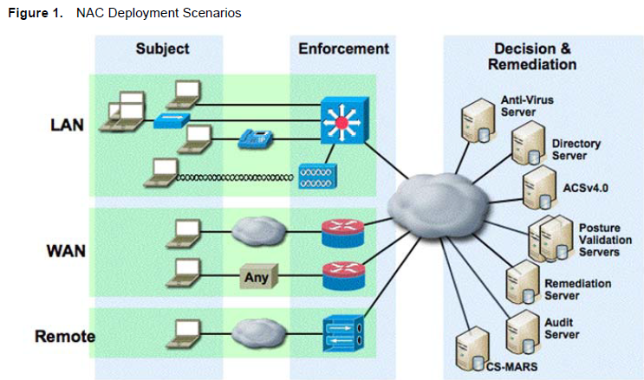
Source: http://www.cisco.com/en/US/solutions/ns340/ns394/ns171/ns466/ns617/net_design_guidance0900aecd80417226.pdf
T. A. Yang
Network Security

